Slide 1





PERSONALISED LEARNING
Team : N.VINOTHAGAN ,vinothagan82@gmail.com
Guide:(P. Raja, Master Trainer, Edu net Foundation)
Disclaimer: The content is curated for educational purposes only.
Notes:
Slides: Prepare a short slide deck (10-12 slides) summarizing the project objectives, methodology, and key results.

Slide 2
OUTLINE
Abstract of the Project
Problem Statement
Proposed Solution
System Architecture
Live Demo of the Project
Embedded Video of Project
Conclusion
Future Scope

Slide 3
Abstract
Personalized learning is an educational approach that tailors instruction to meet the unique needs, preferences, and abilities of individual learners. Unlike traditional one-size-fits-all models, personalized learning leverages technology, data analytics, and differentiated instructional strategies to provide customized learning experiences. This approach promotes student agency, fosters engagement, and enhances learning outcomes by allowing learners to progress at their own pace, access content in diverse formats, and receive targeted support. The integration of adaptive learning systems, real-time feedback, and flexible learning environments plays a key role in supporting personalized learning. However, successful implementation requires thoughtful consideration of equity, teacher training, and the effective use of digital tools. This paper explores the principles, methodologies, and challenges associated with personalized learning, as well as its potential to revolutionize education by catering to the individual learning journey of every student.

Slide 4
Problem Statement
Despite the growing interest in personalized learning as a means to improve educational outcomes, significant challenges remain in its widespread adoption and effective implementation. Traditional educational systems often operate under a one-size-fits-all approach, which fails to address the diverse learning needs, paces, and preferences of individual students. Although personalized learning promises to cater to these differences, its integration into classrooms is hindered by several factors: limited access to technology, inadequate teacher training, the complexity of designing tailored curricula, and the need for robust data systems to track individual progress. Additionally, concerns around equity and the potential for technology to exacerbate existing disparities in education further complicate the realization of its full potential. As such, there is an urgent need to investigate and address the barriers that prevent personalized learning from becoming a standard practice in schools, ensuring that all students, regardless of background, can benefit from a more individualized and effective learning experience.

Slide 5
Proposed Solution
Adaptive Learning Technologies: Use AI-driven platforms that tailor content and pacing to individual student needs, providing personalized learning paths and real-time feedback.
Data-Driven Instruction: Implement systems to track student progress and performance, allowing teachers to adjust instruction and provide targeted support based on real-time analytics.
Flexible, Modular Curriculum: Design curricula that allow students to progress at their own pace, with customizable learning modules and project-based opportunities that align with student interests and strengths.
Teacher Professional Development: Offer continuous training for teachers on using adaptive tools, analyzing data, and differentiating instruction to meet diverse student needs.
Equity and Access: Ensure all students have access to necessary technology and resources, particularly underserved communities, to make personalized learning universally accessible.
Collaborative Learning: Encourage peer interactions through group projects and discussions to promote social learning alongside individualized instruction.

Slide 6
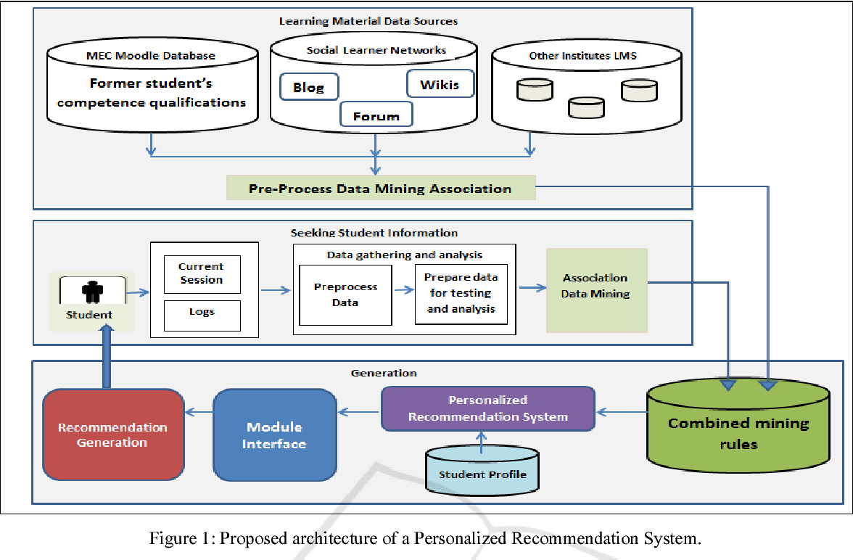
System Architecture

Slide 7
Live Demo of Project

Slide 8
Video of Project Demo

Slide 9
Conclusion
Personalized learning has the potential to revolutionize education by tailoring learning experiences to the unique needs, interests, and abilities of each student. By leveraging adaptive technologies, data-driven insights, and flexible curricula, personalized learning can empower students to take ownership of their education, progress at their own pace, and engage more deeply with content. However, its successful implementation requires thoughtful integration of technology, robust teacher training, and a focus on equity to ensure that all students, regardless of background, have access to the resources and support they need to thrive.
When done effectively, personalized learning can not only improve student outcomes but also foster a more inclusive, engaging, and dynamic learning environment. As educational systems continue to adapt to the demands of the 21st century, personalized learning offers a promising path toward meeting the diverse needs of students, preparing them for success in an ever-changing world. However, it is essential to approach its implementation strategically, continuously refining practices and ensuring that the benefits of personalized learning are accessible to all learners.

Slide 10
Future Scope
The future of personalized learning is promising, with advancements in technology, data analytics, and educational methods. Key developments include:
AI and Machine Learning: AI will enhance adaptive learning platforms, offering more precise, real-time adjustments to students' needs and providing predictive insights to guide instructional decisions.
Scalable Learning Platforms: As technology becomes more accessible, personalized learning will scale globally, providing tailored education to students across diverse regions and educational systems.
Data-Driven Insights: Learning analytics will continue to evolve, offering deeper insights into student progress, helping educators intervene early and personalize learning pathways more effectively.
Holistic Learning: Future models will integrate social-emotional learning (SEL) and focus on students' overall well-being, alongside academic achievement, supporting a more well-rounded educational experience.

Slide 11
Thank you!
Notes:
thank you very much for joining this PPT, keep learning.
11

